Slide 1
BOE /BPAA Release to Process

Slide 2
Release to Process
Release to Process is an enhancement to biotherapy orders that accommodates releasing product to the lab for further processing.
Writing the order: The reprocessing is initiated as a release order with the selection of a Release to Process template. On completing the release order, the provider is prompted to write the associated process order.
The release and process orders that are generated are linked together—one cannot be created without the other. If the release order is signed and the process order is then canceled, the release order is also canceled.
Confirmation of the orders by nursing must be completed in sequence. First the release order must be confirmed to lab, then the process order.
In BPAA, the lab must complete the release order before the process order.

Slide 3
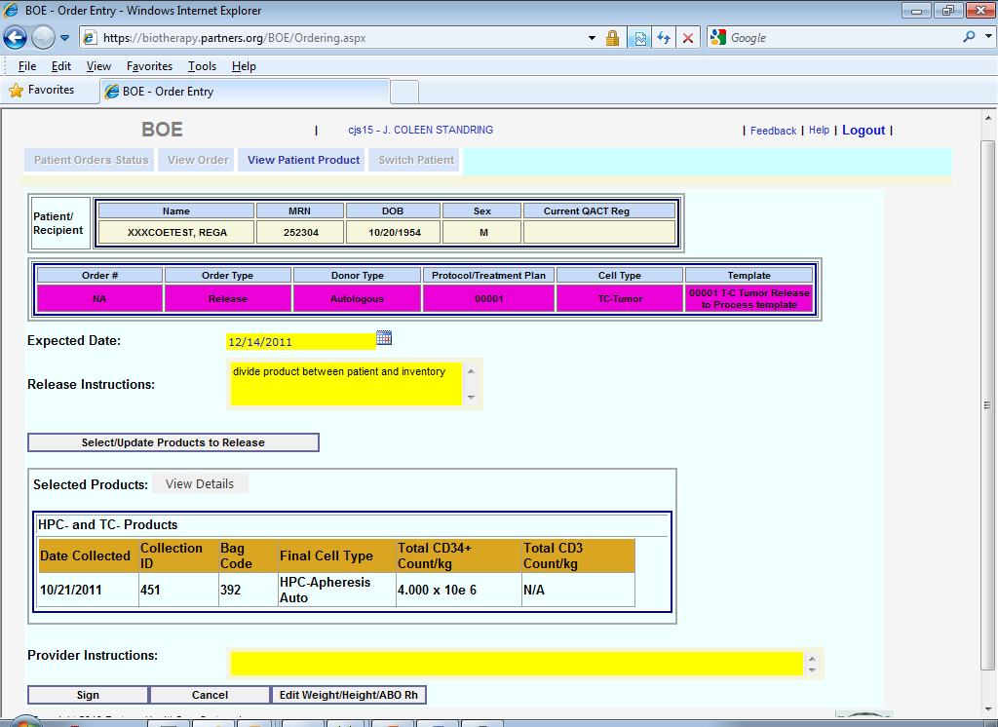
Release to Process Template

Slide 4
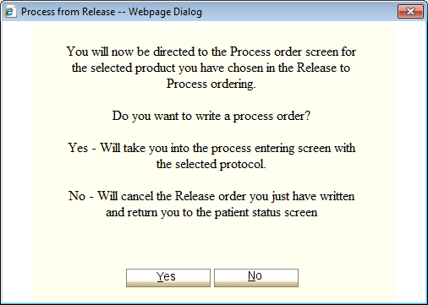
Process Order Prompt
On signing a release order written with a Release to Process template, the ordering provider is prompted to continue with the associated process order.
Selecting No at the prompt cancels the Release order and puts the product back into the patient’s inventory.
Selecting Yes starts the process order.

Slide 5
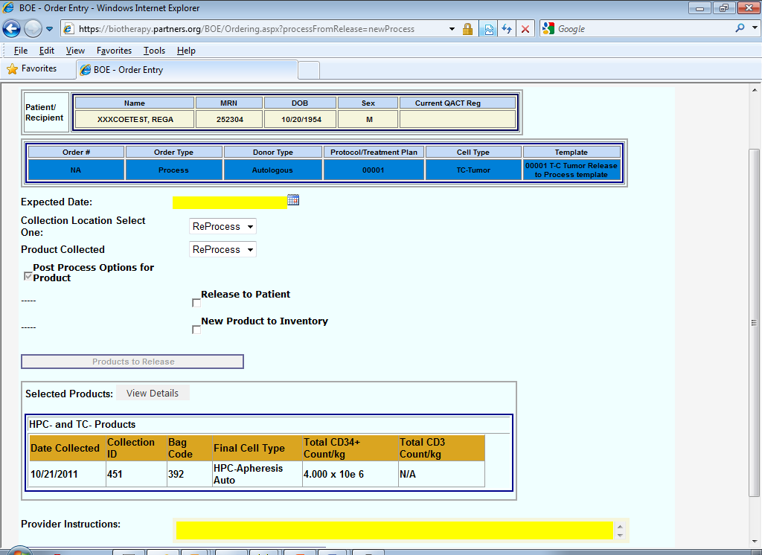
Release to Process
The Collection location and Product Selected for the process order are automatically set to “ReProcess.”
The product selected for the release order displays, and is included in the printout of the order.

Slide 6
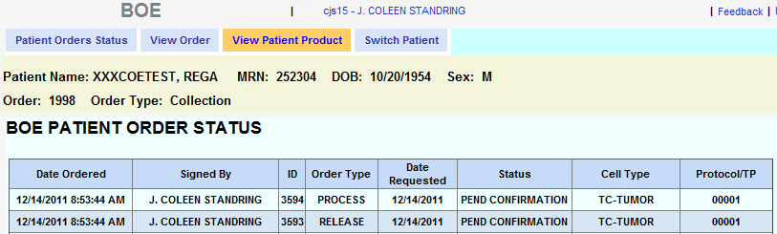
Release to Process
Once the Process order is signed, the Release and Process orders are saved together to the patient’s BOE orders list

Slide 7
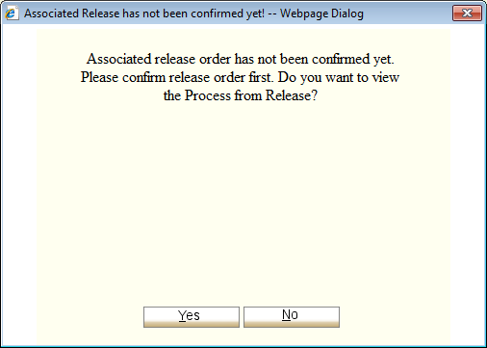
Release to Process Confirmation
The RN must confirm the release order first, then the associated process order. On trying to confirm the process order before the release order, the RN can only view the process order.

Slide 8
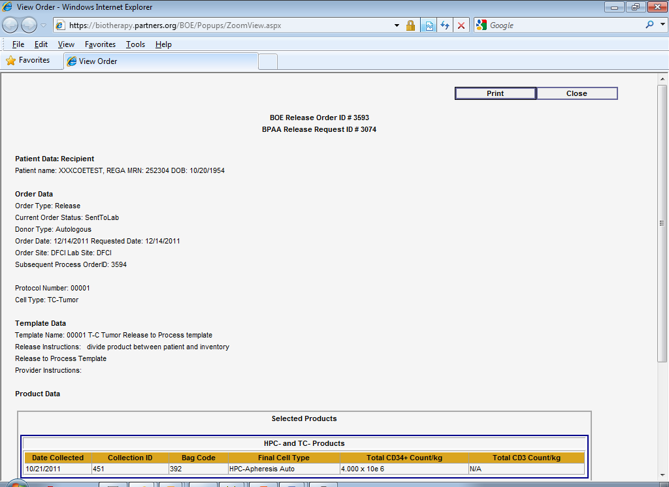
Detailed Order Views
The detailed view of the printout for both orders includes a link to the associated order
Both the release and process orders display the selected product

Slide 9
Release to Process
Rules for Use and Things to Know
Only templates built with Release to Process in the name, and both the Collection Location and Process Collected set to “ReProcess,” have the linked release and process orders for reprocessing selected product.
A release order is not created if the associated process order is canceled. The product selected in the release order is added back to the patient’s inventory.
After writing the release order, if the ordering provider times out, backs out, or exits out of writing associated the process order without choosing to cancel, the release order will not be saved. After 15 minutes the selected product is returned to the patient’s inventory.
RNs must confirm the release order before the process order.
Canceling either the release or the process order in BOE will cancel the associated order and return the product to the patient’s inventory.
In the Zoom detailed view and printout of both orders, the associated order for process or release displays with the BOE order ID.
The processing lab BPAA system does not allow the process order to be started until the release order is documented as Completed.
If the lab cancels the release order through BPAA, the only option for the associated process order is to cancel.

